Slide 1


Internet Routing Registry Tutorial
Internet Routing Registry Tutorial
AIS’19 | June 2019
Dev & Keessun
irr@afrinic.net
SAFNOG-5 | August 2019
James Chirwa
irr@afrinic.net

Slide 2
Objectives
Whois Database Refresher
Overview of the AFRINIC IRR
Outline the benefits of the AFRINIC IRR
Discuss the RIPE NCC NWI-5 Implementation
Upcoming changes to the AFRINIC IRR
How to create Route objects
How to replicate objects from RIPE

Slide 3
WHOIS DB - Database Objects
An object is a set of attributes and values
• Each attribute of an object...
• Has a value
• Has a specific syntax
• Is mandatory or optional
• Is single- or multi-valued
• Some attributes ...
• Are primary (unique) keys
• Are lookup keys for queries
• Are inverse keys for queries
Object “templates” illustrate this structure

Slide 4
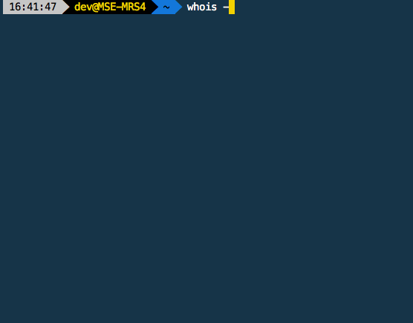
WHOIS DB - Inetnum Object Example

Slide 5
WHOIS DB - Database Queries
Two ways to query the AFRINIC whois database:
The Whois Web Interface accessible at:
https://whois.afrinic.net
The Whois CLI client which can be downloaded at:
http://ftp.afrinic.net/db/
$ whois -h whois.afrinic.net -rB 196.1.0.0/24

Slide 6
WHOIS DB - Object Protection
Objects on the whois database are protected by a maintainer(mntner) via the ‘mnt-by’ attribute. The maintainer is itself an object on the AFRINIC whois database.
Each maintainer object has a password or PGP key linked to it which will be required when creating or updating other objects which are protected by the maintainer.

Slide 7
Overview of the AFRINIC IRR

Slide 8
What is a Routing Registry?
Distributed databases with public routing policy information, mirroring each other: AFRINIC, RIPE, APNIC, RADB, Level3, etc...
BGP does not provide a mechanism to publish/communicate the policies themselves
The routing registry provides this functionality
Routing policy information can be published in a series of objects
Stability and consistency of routing
Network operators share information

Slide 9
Why do we need a routing registry?
The IRR contains announced routes and routing policy in a common format that network operators can use to configure their backbone routers.
Document routing policy
Required by some Transit Providers & IXPs
they use it for prefix-based filtering
Allows for automated generation of prefix filters and router configuration commands, based on the RR using tools such as bgpq3 or IRRtoolset. Prefix filtering based on IRR registered routes prevents accidental route leaks and prefix hijacking

Slide 10
The AFRINIC IRR
AFRINIC’s Internet Routing Registry(IRR) was launched during its AFRINIC-18 meeting(17th June 2013). Previously, AFRINIC members were asked by AFRINIC to add route(6) objects on the RIPE NCC’s IRR. Some members also had routing policy information displayed in 'remarks' fields in the AFRINIC WHOIS itself.
How was it possible to create route objects on the RIPE Database?
Using a well-known maintainer(RIPE-NCC-RPSL-MNT) which had a ‘public’ password
Possible to create any new AUT-NUM or ROUTE(6) objects for non-RIPE managed resources

Slide 11
AFRINIC IRR Features
Open to AFRINIC Resource members and Legacy Resource Holders in AFRINIC service region.
The AFRINIC IRR is a free service
AFRINIC IRR is mirrored by the other IRRs such as APNIC, RIPE NCC, NTTCOM, AMS-IX, Work Online(SA), Moscow IXP and RADB.
Stable source of routing information.
Secure: the mnt-by, mnt-lower authentication attributes in inetnum objects are checked to ensure the member has control over routing objects that specify their resources.
AFRINIC is the single point of contact for both Internet Resource Management and Routing Registry

Slide 12
AFRINIC IRR Roadmap June 2013 - Sept 2018
June 2013: Deployment of AFRINIC IRR
2013 to 2018: Various AFRINIC initiatives to increase IRR adoption and member education on how to to use the AFRINIC IRR (bootcamps, documentation on website, tutorials during outreach, assistance during face to face consultations, migration tool)
Enhancements to Business Rules in May 2016, to address some issues experienced by the AFRINIC membership
September 2018: RIPE NCC implemented NWI-5(Numbered Work Items - 5) on their IRR database
Notes:
We encourage AFRINIC members to migrate any route(6) objects to the AFRINIC Routing Registry without delay. The AFRINIC IRR is a free service
for AFRINIC members, and it supports very similar features to the RIPE NCC IRR.
Migration to the AFRINIC IRR should be easy for members who have an AFRINIC-issued ASN and AFRINIC-issued IP addresses.
However, resource holders who have a non-AFRINIC ASN will require staff intervention for every route(6) object that they create. We recognise that this is not scalable, and we have created a focus group of AFRINIC staff, working in close collaboration with the RIPE NCC, to design a long-term solution to this issue.

Slide 13
RIPE NWI-5 Changes in a nutshell..
The RIPE-NCC-RPSL-MNT maintainer was deleted
Creation of out-of-region aut-num(ASN) is no longer possible
The RIPE RR no longer supports the creation of out-of-region route(6) objects
Existing non-RIPE-managed route(6) objects have been moved under the source: “RIPE-NONAUTH”
The existing out-of-region objects may eventually be deleted after further discussion by the RIPE Database Working Group

Slide 14
RIPE NWI-5: Implications for AFRINIC members
Operators can opt to lookup object with "source: RIPE" only, else their scripts or automation tools may filter out-of-region route(6) objects (as their authorisation is questionable) or treat them with a lower preference. Your legitimate route announcement may be filtered and this will eventually result in network outages.
The changes may not be affecting you at the moment if your upstream does not filter route(6) objects based on the “source”. However, the RIPE DBWG is yet to decide to delete the out-of-region objects or not.
No longer able to create route(6) objects in the RIPE IRR DB using IP resources from AFRINIC.

Slide 15
RIPE NWI-5: Migrate to AFRINIC IRR
If you have IP prefixes delegated by AFRINIC, we highly recommend using the AFRINIC IRR to publish your routing policy.
The AFRINIC & RIPE IRR Similarities:
RPSL
Quasi similar object attributes
Authentication against maintainers
RIPE mirrors the AFRINIC IRR
Use WHOIS web-client
Use Email updates

Slide 16
AFRINIC IRR - Previous Business Rules
The route(6) object creation were possible for the following scenario:
Both ASN and IPv4/IPv6 prefix(es) were issued to your organisation
Authentication for IPv6/IPv6 and ASN in route(6) object is required
IPv4/IPv6 was issued to one ORG and ASN to another ORG.
Both ASN and IPv4/IPv6 prefixes were registered in AFRINIC WHOIS
Dual Authentication of IPv4/IPv6 & ASN holders is required

Slide 17
AFRINIC IRR - Previous Business Rules
Out Of Region (OOR) ASN (ASN not registered in AFRINIC WHOIS but registered as delegated in other RIRs whois db)
OOR ASN Registered under member’s org details in another RIR’s whois db.
Manual Hostmaster intervention was required
Hostmasters create the route object after validation.
Not supported: OOR ASN not delegated to member as per organisation details

Slide 18
AFRINIC IRR - Current Business Rule
On the 27th September 2018, AFRINIC implemented the new rules for the route(6) object creation, the following shall then be possible:
No ASN authorisation requirement for ROUTE(6) object creation
Autonomously create route objects where the IPv4 or IPv6 is from the AFRINIC service region
Only authentication required against IP prefix’s maintainer
Regardless of where the ASN is domiciled or who is the holder of the ASN
No hostmaster intervention required for route(6) creation where the ASN is not issued by AFRINIC

Slide 19
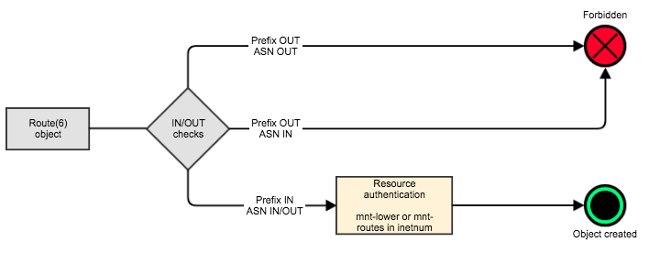
AFRINIC IRR - New Creation Workflow

Slide 20
AFRINIC IRR - Create route(6) objects
Route(6) Creation in 4 steps:
The IP prefix must be an AFRINIC managed IP resource and an inet(6)num object must exist on the AFRINIC whois.
Ensure that there is an mnt-lower or mnt-routes in the inet(6)num
Get the route(6) object template and fill in all the mandatory attributes
Submit the route(6) object for creation by authenticating against the maintainers in the inet(6)num

Slide 21
The mntner object
mntner is an abbreviation of maintainer
Identifies accounts in the registry
Specifies authentication mechanism in the “auth” attribute. Either:
PGP-KEY - PGP/GPG based auth
(B)CRYPT-PW / MD5-PW - password auth
MAIL-FROM - email based auth
(MD5-PW, CRYPT-PW and MAIL-FROM are now deprecated)

Slide 22
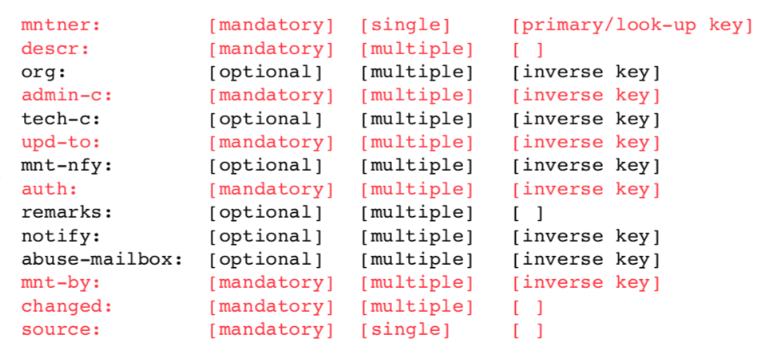
Sample mntner object

Slide 23
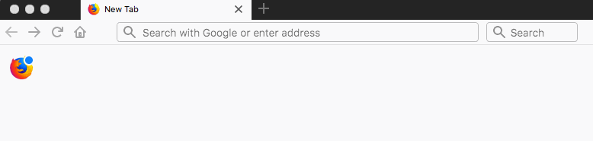
AFRINIC IRR - Using Web Update
To access the AFRINIC Web Interface, go to http://whois.afrinic.net

Slide 24
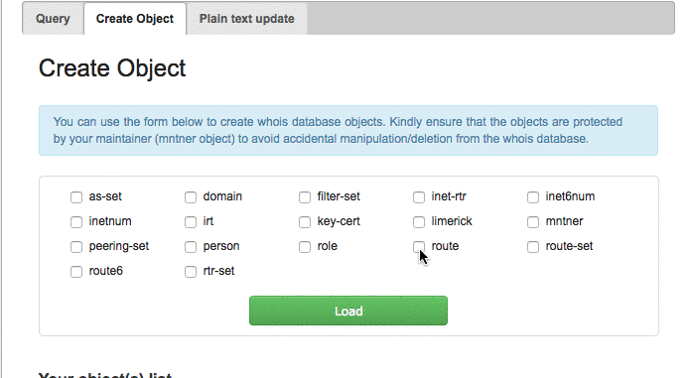
AFRINIC IRR - Using Web Update
Get the route(6) object template and fill in all the mandatory attributes

Slide 25
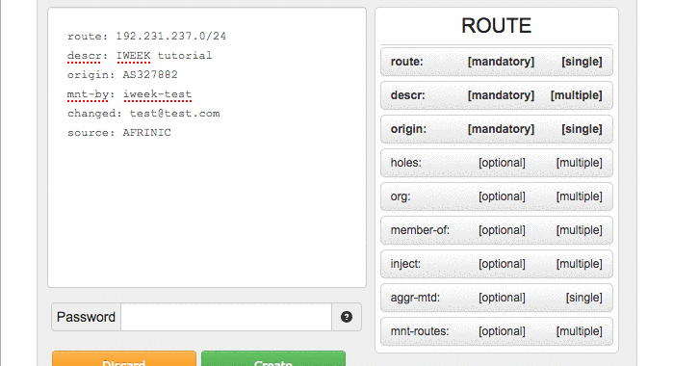
AFRINIC IRR - Using Web Update

Slide 26
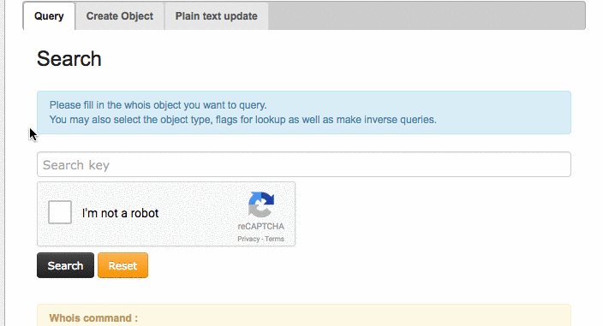
AFRINIC IRR - Using Web Update

Slide 27
AFRINIC IRR - How to Bulk Create Route(6) Objects
To bulk create Route(6) Objects:
Create a text file with all the route(6) objects
Ensure that you provide the password for the maintainer referenced in the inet(6)num on each object
Submit the route(6) objects for creation
Using the Whois Web Interface
Using the Email Update method

Slide 28
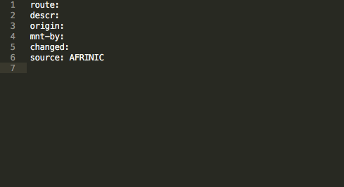
AFRINIC IRR - How to Bulk Create Route(6) Objects
Create a text file with all the route(6) objects
Example: Bulk create objects for 196.192.48.0/20, 196.192.48.0/21 & 196.192.56.0/21 with AS327800 as the origin

Slide 29
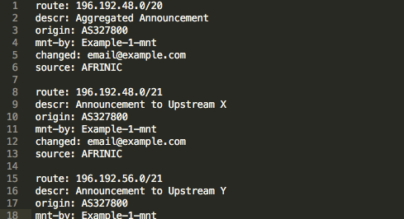
AFRINIC IRR - How to Bulk Create Route(6) Objects
Provide the password for the maintainer referenced in the inet(6)num
In this example, we need to provide the password for Example-1-mnt for each object.

Slide 30
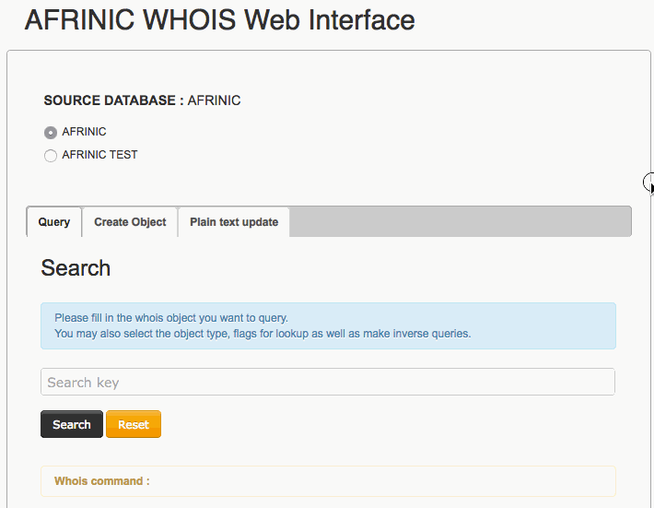
AFRINIC IRR - How to Bulk Create Route(6) Objects
Submit the route(6) objects for creation
Using the Whois Web Interface

Slide 31
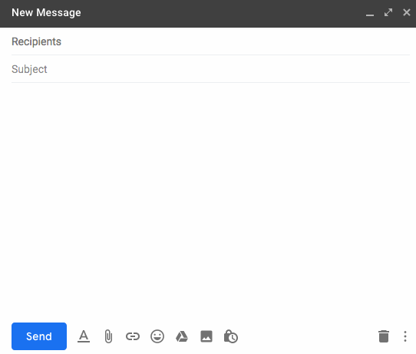
AFRINIC IRR - How to Bulk Create Route(6) Objects
Submit the route(6) objects for creation
Using the email update method

Slide 32
Replicate Route(6) Objects
There are multiple ways to replicate route objects to the AFRINIC IRR. The most straightforward steps to bulk create your route objects are summarised below;
Get the route objects to replicate from other IRR database(s)
Review the objects and remove obsolete ones
Ensure that the objects have all mandatory attributes
Update the “mnt-by” with the “mnt-lower” or “mnt-routes” in the inetnum object.
Submit the objects for creation

Slide 33
Replicate Route(6) Objects
Step 1 - Get the route objects to be replicated
Query the IRR DB to retrieve all your route objects. You can use the IRR Explorer in case you are not aware on which IRR DB your route objects are.
A list of all IRR databases can be found on RADB’s website and you may use a whois CLI client or their whois web interface, if available, to query the databases.
You can get all your existing routes objects in APNIC, RADB, RIPE IRR on the AFRINIC website.

Slide 34
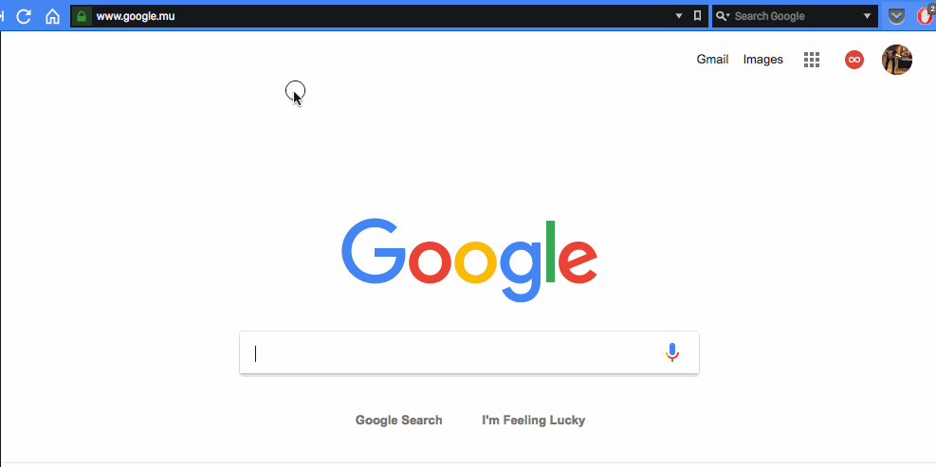
Replicate Route(6) Objects
View all your existing routes objects in APNIC, RADB, RIPE IRR on the AFRINIC website.

Slide 35
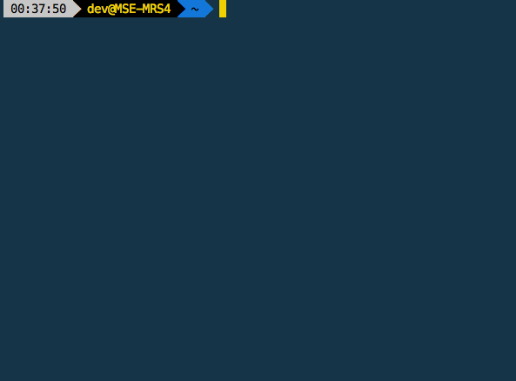
Replicate Route(6) Objects
View existing objects in the RIPE DB using the Whois CLI client

Slide 36
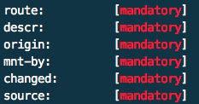
Replicate Route(6) Objects
Step 2 - Review the objects to remove any obsolete ones
It is recommended that you go through the all the route objects and identify any obsolete objects
Step 3 - Ensure that the objects have all mandatory attributes
Different IRRs may have different set of rules and attributes. In order to create the route objects all the mandatory attributes must be present.

Slide 37
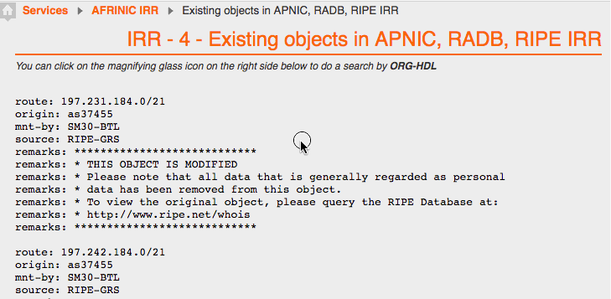
Replicate Route(6) Objects
Ensure that the objects to be replicated have all mandatory attributes

Slide 38
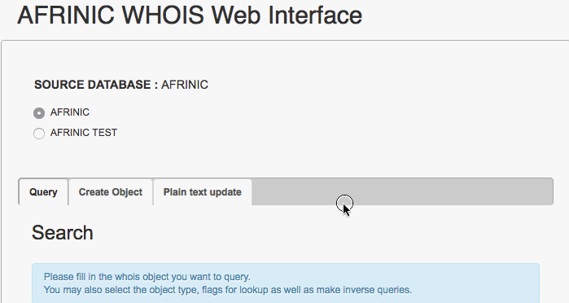
Replicate Route(6) Objects
Update the “mnt-by” with the “mnt-lower” or “mnt-routes” in the inetnum object

Slide 39
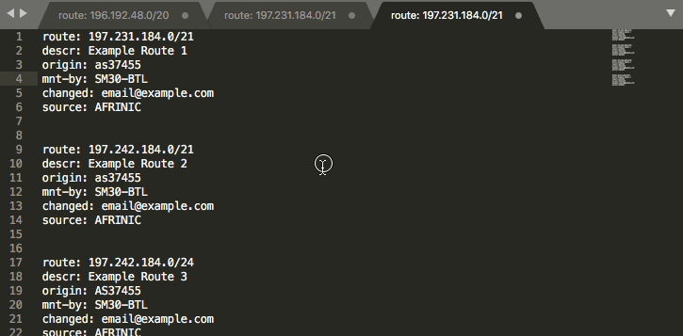
Replicate Route(6) Objects
Update the “mnt-by” with the “mnt-lower” or “mnt-routes” in the inetnum object

Slide 40
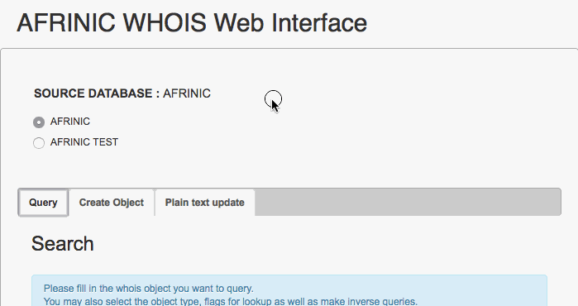
Replicate Route(6) Objects
Submit the objects for creation

Slide 41
Verify Your IRR Object
Using WHOIS command line tool
Whois -h whois.afrinic.net -rB <YourIPPrefixASN>
Or whois -h whois.afrinic.net -rB <Your IP Prefix>
Using the whois web interface (whois.afrinic.net)
Input search value (IP block)
Click flags and select “r” and “B”
Click search

Slide 42
Route Filtering with IRR
Creates route-map, AS path and ingress/egress filters
route filtering using Internet Routing Registry (IRR) no longer an option, it’s simply the right thing to do.
Avoid filter errors (typos)
Filters consistent with documented policy
Notes:
Filters consistent with documented policy but need to get policy correct though

Slide 43
Recommendations
Members read through AFRINIC IRR docs published, to ensure ease of use of the AFRINIC IRR
Contact details kept up to date after staff movements.
Maintainer passwords are kept up to date
If you hold resources from AFRINIC, have your route object registered in the AFRINIC IRR
Replicate route objects from other IRRs to AFRINIC to avoid being filtered after housekeeping by the other IRRs
Inform AFRINIC in case your upstream provider does not accept routes from the AFRINIC IRR, but insists on you using some other IRR.

Slide 44
Recommendations
If you are an upstream provider using IRR to generate your filters and router configs:
Ensure your filters have been updated after the RIPE changes with source “RIPE-NONAUTH” to allow objects still on RIPE NCC’s IRR
Ensure your filters are updated with the AFRINIC IRR
Encourage adoption of AFRINIC IRR by your customers to ensure reliable routing information.

Slide 45
Be heard, Be Engaged!
The AFRINIC Database Working Group is an open mailing list available for knowledge sharing and for proposing new ideas/solutions
Feel free to contribute your ideas on this list
Subscribe to our DBWG via https://lists.afrinic.net/ then “dbwg”
For any further help, contact irr@afrinic.net

Slide 46

afrinic afrinic afrinic
afrinic
afrinic
afrinic
twitter.com/ flickr.com/
facebook.com/ linkedin.com/company/ youtube.com/ www.
media
.net
Thank you for your Attention
Questions?

